Slide 1
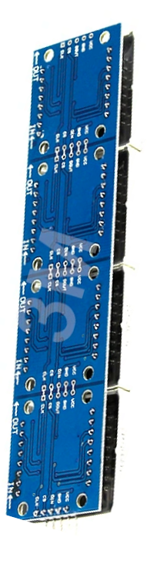

Slide 6
Slide 5
Welcome to Module Matrix 8x32 LED
Slide 4
MAX7219 Arduino Xanh Dương MT-832-G
Slide 3
Slide 2
Slide 1

Slide 2
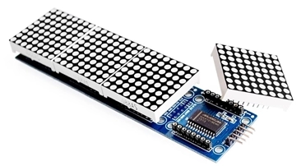
CONFIGURATION
Slide 6
● Size: 8x32 LEDs, consisting of 4 matrices 8x8 stitched together.
● Blue LED Matrix
Slide 5
● Operating Voltage: 5V
● IC driver: Max7219
● Dimensions: Length: 130mm. Height: 32mm. Width: 14mm
Slide 4
● Communication follows the SPI standard, utilizing RCLK and DIO.
Slide 3
Slide 2
Slide 1
Notes:
Configuration

Slide 3
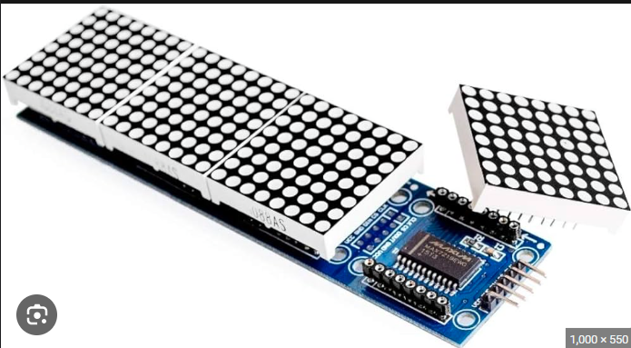
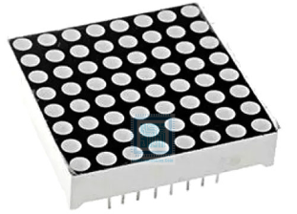
PRINCIPLE OF OPERATION
32 Columns
Slide 6
Slide 5
8 Rows
Slide 4
Slide 3
8 Columns
8 Rows
Slide 2
Slide 1
Notes:
Principle of operation

Slide 4
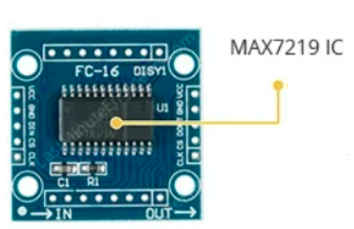
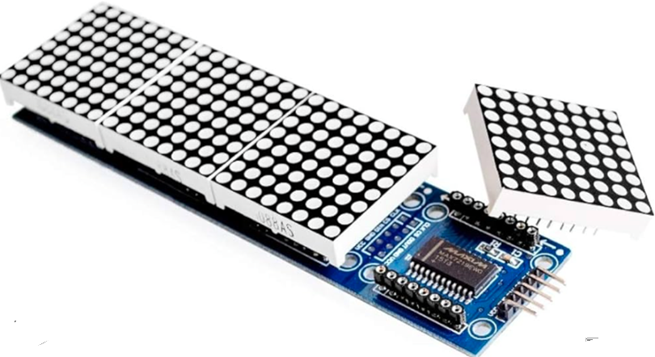
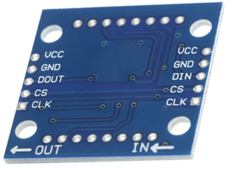
PRINCIPLE OF OPERATION
Slide 6
Slide 5
Slide 4
Slide 3
Slide 2
Slide 1
Notes:
Principle of operation

Slide 5
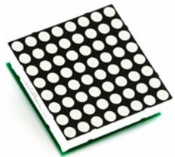
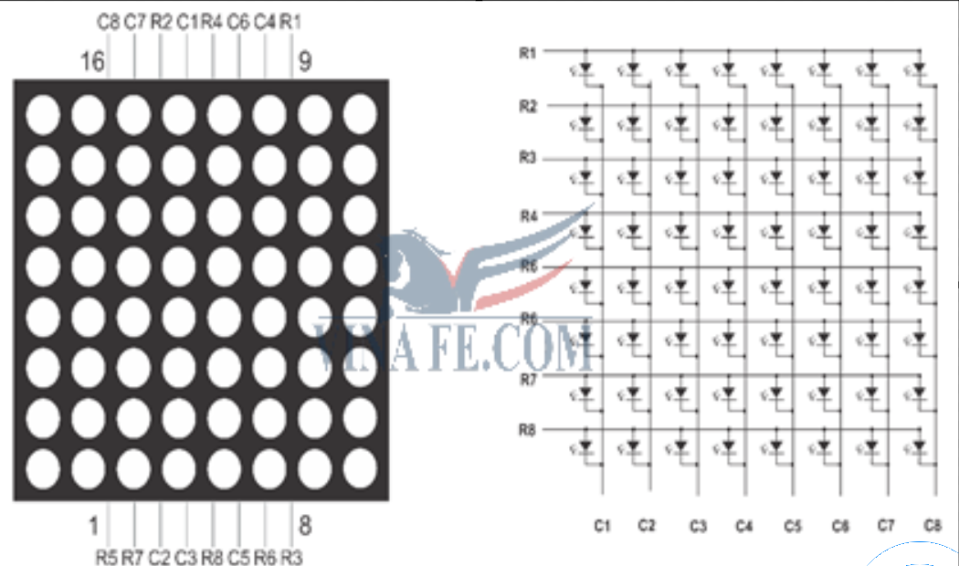
PRINCIPLE OF OPERATION
● Connecting all rows and columns together is done to reduce the number of pins required to control each LED dot.
Slide 6
Row
Slide 5
Anode
Slide 4
Slide 3
Slide 2
Column
Slide 1
→ Multiplexing
Cathode
Notes:
Principle of operation

Slide 6
PRINCIPLE OF OPERATION
Slide 6
Slide 5
Slide 4
Slide 3
● MAX7219 is an Integrated Circuit (IC).
● Used to connect multiple LED displays or LED matrices.
Slide 2
● It reduces the complexity of controlling LEDs and displaying numbers or characters.
Slide 1
● It handles all control and refresh tasks → sent via SPI communication.
Notes:
Principle of operation

Slide 7
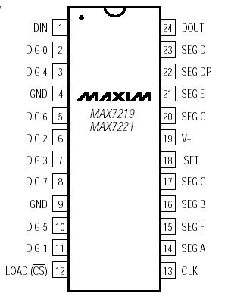
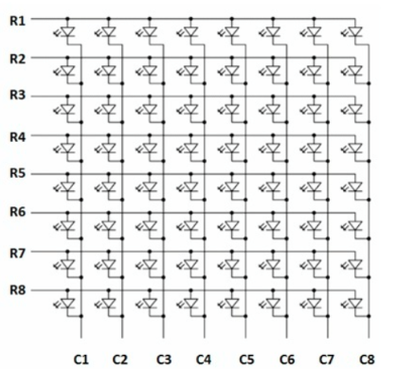
PRINCIPLE OF OPERATION
Slide 6
Slide 5
Slide 4
Slide 3
Slide 2
Slide 1
Notes:
Principle of operation

Slide 8
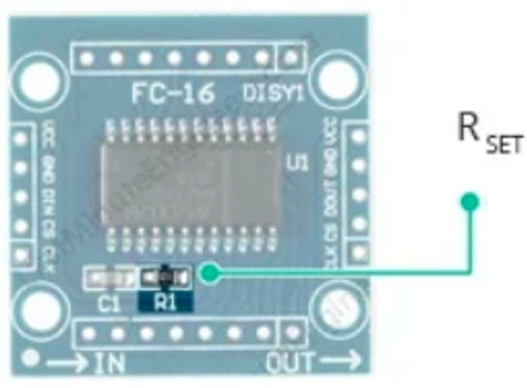
PRINCIPLE OF OPERATION
Slide 6
Slide 5
Slide 4
Slide 3
● RSet resistor: used to adjust the brightness of the 8x8 LED matrix.
Slide 2
● Control the maximum current supplied to the LED.
Slide 1
Notes:
Principle of operation

Slide 9
PRINCIPLE OF OPERATION
Slide 6
SPI communication.
Slide 5
● Used to transmit and receive data from Arduino or any other data source.
Slide 4
● This communication includes: CLK (Clock), DIN (Data In), CS (Chip Select), and DOUT (Data Out - shared between MAX7219 when connected in a daisy-chain)..
Slide 3
Slide 2
Slide 1
Notes:
Principle of operation

Slide 10
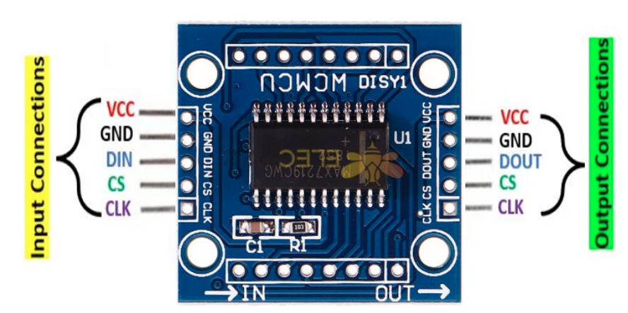
FUNCTION OF THE PINS
Slide 6
Slide 5
Slide 4
Slide 3
Input Connections
● VCC: Connected to 5V (Anode)
● GND: Ground connection (Cathode)
Slide 2
● DIN: Data In pin. Connect it to any digital pin of the microcontroller.
● CS: Chip Select (sometimes labeled as LOAD).
Slide 1
● CLK: Clock pin. This pin receives clock signals to synchronize the data transfer into IC.
Notes:
Function of the pins

Slide 11
FUNCTION OF THE PINS
Slide 6
Slide 5
Slide 4
Slide 3
Output Connections
● VCC: Connect to the 5V pin of the next module.
● GND: Connect to the GND pin of the next module.
Slide 2
● DOUT: Data Out pin, connects to the DIN pin of the next module.
● CS: Connect to the CS/LOAD of the next module.
Slide 1
● CLK: Connect to the CLK pin of the next module.
Notes:
Function of the pins

Slide 12
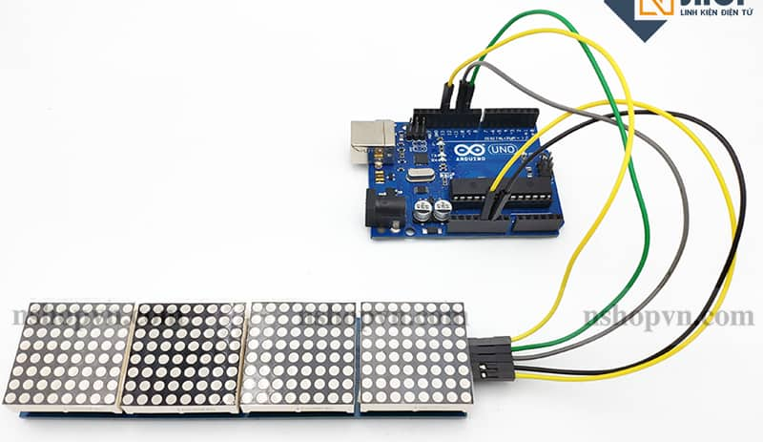
HOW TO USE
● VCC - 5V (VCC is the power supply pin)
Slide 6
● GND - GND
● DIN (Data In) - Digital 11 (This is the pin for transmitting data from the microcontroller to the MAX7219)
Slide 5
● CS - Digital 10 (pin for selecting the operation of the module)
● CLK (Clock pin) - Digital 13 (pin providing clock pulses for the MAX7219)
Slide 4
Slide 3
Slide 2
Slide 1

Slide 13
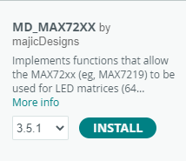
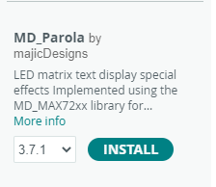
HOW TO USE
Include the two libraries: MD_MAX72xx and MD_Parola.
Slide 6
Slide 5
Slide 4
Slide 3
● Provide functions to configure and control LED devices through SPI communication.
● An extension of MD_MAX72xx
Slide 2
● To simplify the display of text and create motion effects on the LED matrix
Slide 1

Slide 14
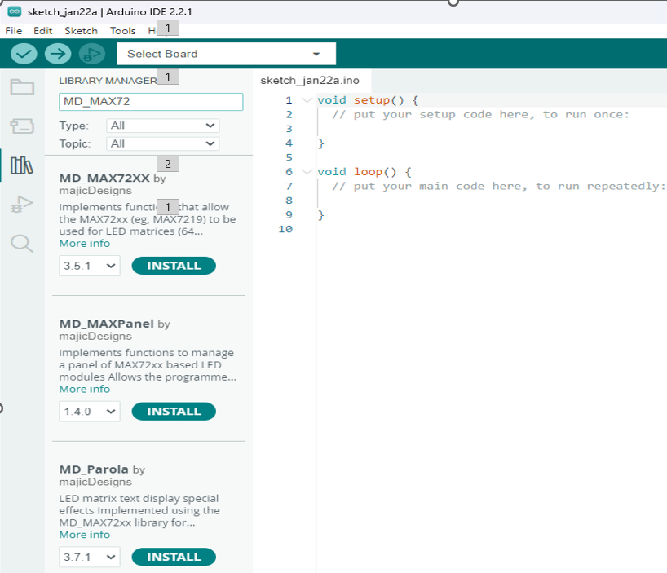
HOW TO USE
The reason for using both libraries:
Slide 6
● Combine the power of MD_MAX72xx for hardware control.
Slide 5
● Leverage the flexibility of MD_Parola for displaying text and effects.
Slide 4
To install:
Slide 3
Open Arduino IDE → select Sketch → Include Library → Manage Libraries, then search for "MD_MAX72xx".
Slide 2
Slide 1

Slide 15
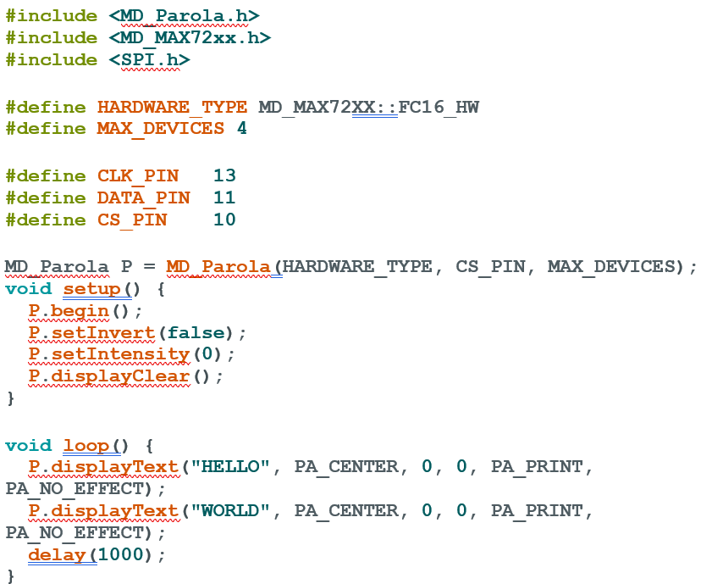
Slide 6
Slide 5
Slide 4
Slide 3
Slide 2
Slide 1

Slide 16
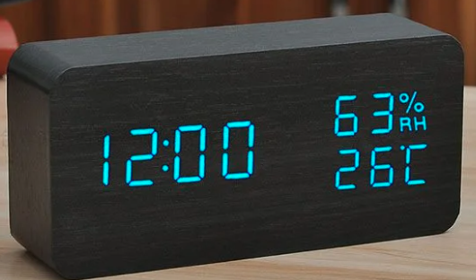


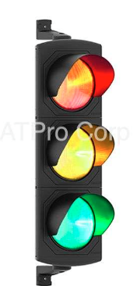

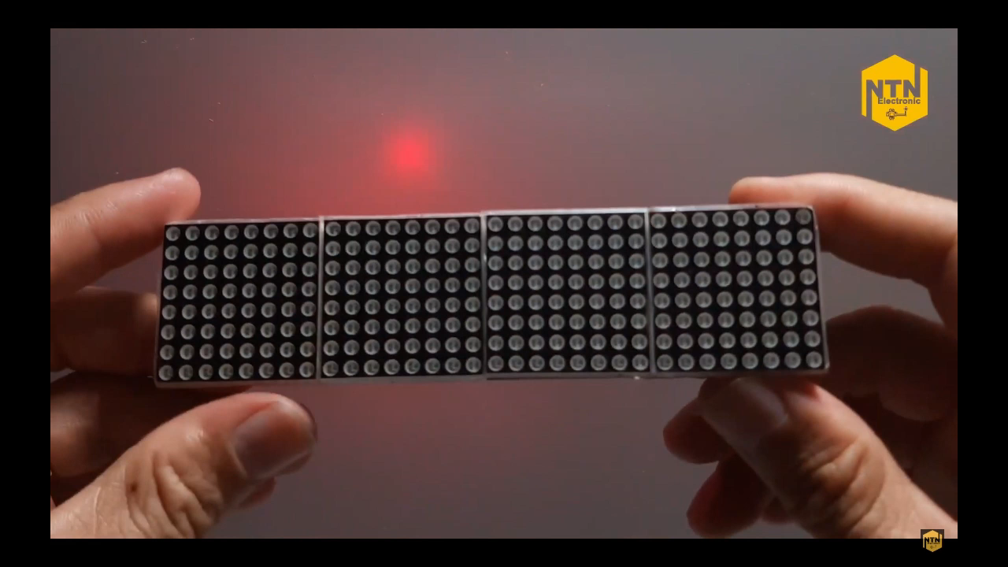


APPLICATION
Slide 6
Display Weather Information
Slide 5
Clock and Alarm
Slide 4
Display Messages and Notifications
Slide 3
Scrolling Text and Text Effects
Slide 2
Display Traffic Route Information
Slide 1
Notes:
Application

